Slide 1


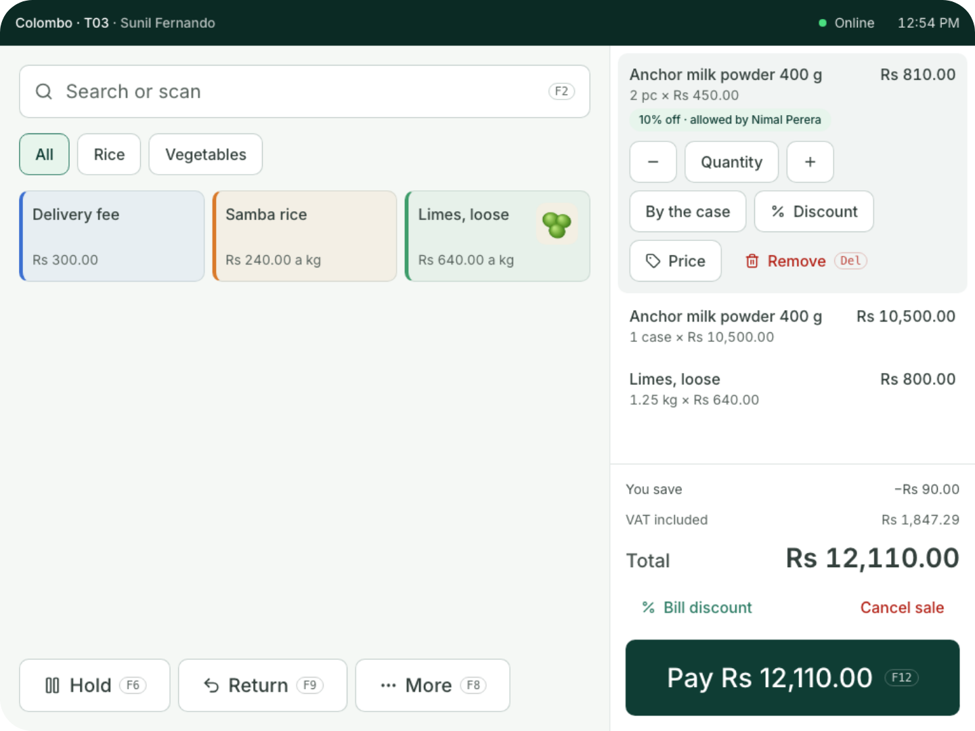
For restaurants, cafés, bakeries and shops
You sell.
Coredile does the
rest.
A till that keeps billing when the internet drops, and does your
stock, food costs and accounts while you sell.
Notes:
Thank you for your time today. I’m going to show you Coredile POS. It is a billing system, but it does much more than print a bill. In the next few minutes you’ll see how it saves you time every day, and how it shows you where your money goes. Please stop me and ask questions at any time.

Slide 2




THE USUAL WAY
Most tills stop at the bill.
The customer leaves. Then the real work starts.
Counting stock by
hand on Sundays
Typing the day’s
sales into Excel
A bag of papers
for the accountant
Guessing what
each item really
costs
Coredile does all of this for you, with every bill.
Notes:
Most tills only print the bill. After that, the owner still does a lot of work by hand. Someone counts the stock. Someone types the sales into Excel at night. The accountant asks for a bag of papers every month. And most owners are not sure what one plate or one item really costs them. Ask them: which of these do you do today? Coredile takes these jobs away.

Slide 3





THE BIG IDEA
One bill. Five jobs done for you.
Kitchen
The ticket prints for 2 kottu
Table 4
Paid in cash
Stock
2 × Chicken kottu
2,200
Chicken, rotti, eggs and Milo come off
2 × Iced Milo
900
Food cost
Service charge 10%
310
Rs 1,180 of ingredients on this bill
Accounts
Total
Rs 3,410
Sale, service charge and cash written in
Morning email
Part of yesterday’s figures, sent at 7 a.m.
Notes:
This is the heart of Coredile. The cashier does one thing: ring up the bill. Then Coredile does five jobs by itself. The kitchen gets its ticket. The chicken, rotti, eggs and Milo come off the stock. It works out what the food cost you. It writes the sale into the accounts. And tomorrow at 7 in the morning, the owner gets an email with yesterday’s figures. Nobody types anything twice. (In Present mode, each job appears one by one as you click.)

Slide 4


AT THE COUNTER
Easy to learn.
Quick to use.
Tap a button or scan a barcode
Cash or card, with the change worked
out for you
Big discounts and refunds need a
manager’s PIN
At closing, the till tells you if the cash is
short or over
Notes:
This is the real till screen. Big buttons, clear prices, and the total always on the right. A new cashier learns it in one shift. They tap a product or scan the barcode, take cash or card, and the till shows the change. If someone gives a big discount or a refund, a manager has to put in their PIN, so nothing happens without the owner knowing. At closing time, the cashier counts the cash, and the till shows straight away if anything is missing.

Slide 5
WHEN THE INTERNET DROPS
No internet? Keep billing.
Each till keeps its own copy of your menu, prices and staff. It does not need the internet to sell.
1
2
3
Internet off
Keep selling
Internet back
The till carries on as if nothing
happened.
Bills print as normal. Your
customers never notice.
Every bill goes up by itself, in
order. Nothing is lost.
Up to 3 days without internet. In a restaurant, waiters’ phones and kitchen tickets keep working too, over your own Wi-Fi.
Notes:
Power cuts and internet problems happen. With most online systems, billing stops and the queue gets longer. Coredile is different. Each till has its own copy of everything it needs. When the internet goes, the cashier keeps billing and printing as normal. When the internet comes back, every bill is sent up by itself, in the right order. Nothing is lost. A till can work for up to 3 days without internet. In a restaurant, the waiters’ phones and the kitchen keep working too, over your own Wi-Fi.

Slide 6
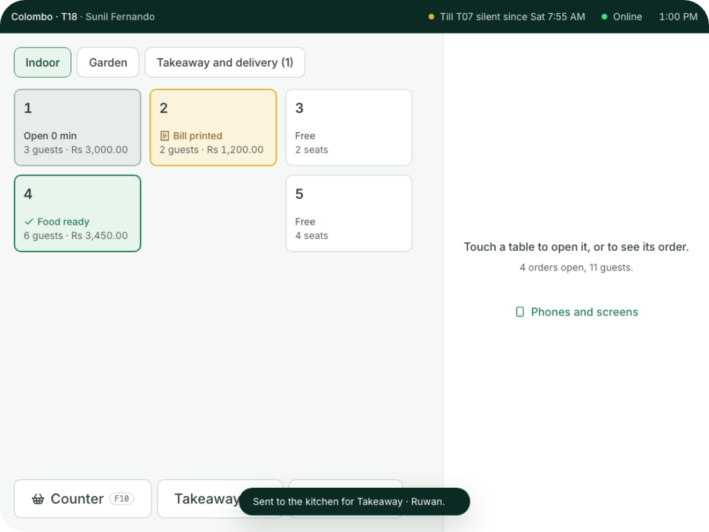
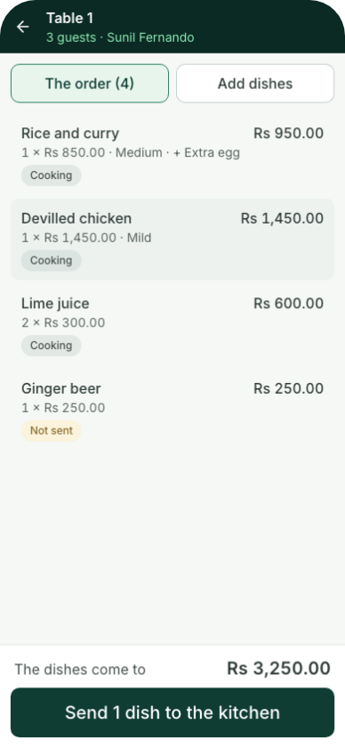
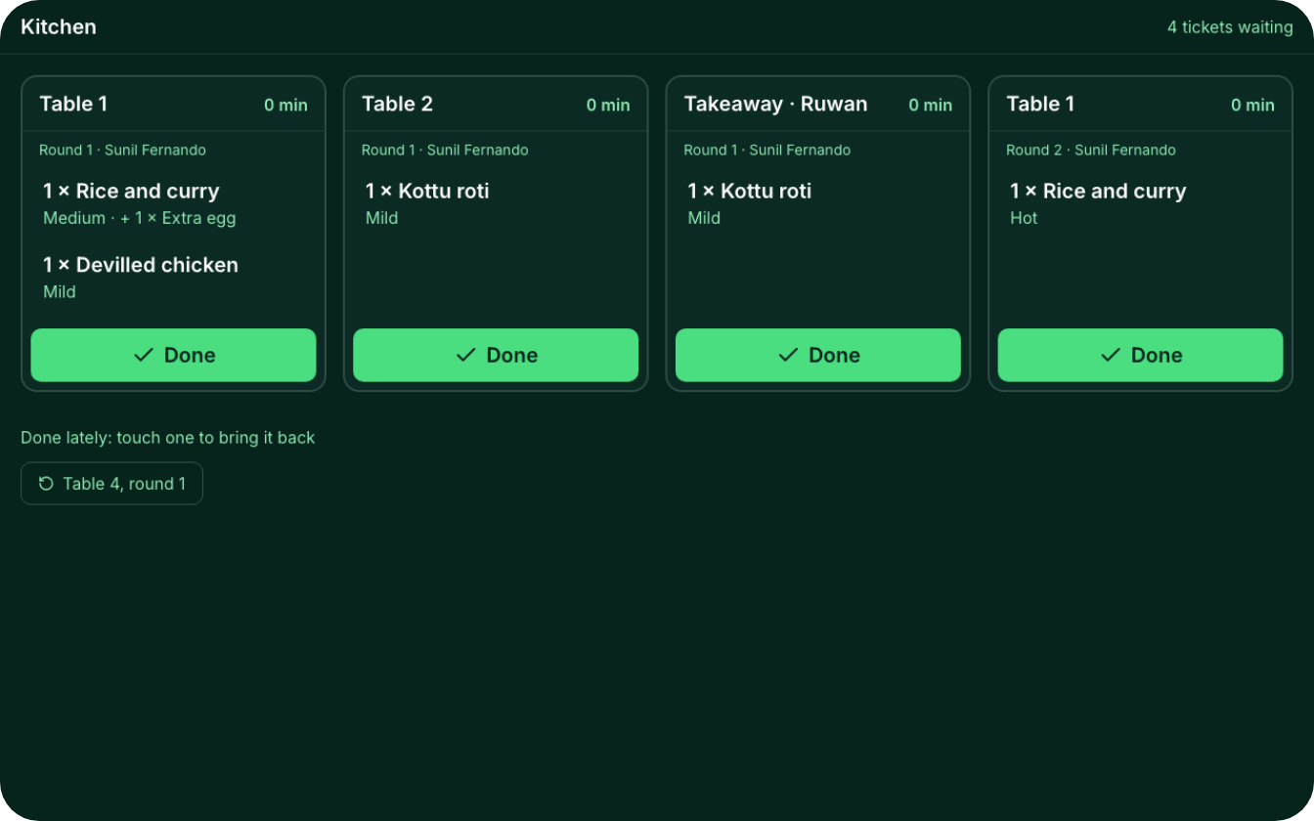
FOR RESTAURANTS
Your whole restaurant, connected.
Every table at a glance
Waiters use their
phones
A screen for the kitchen
See which tables are free, waiting for food, or ready to
pay.
Each ticket shows up the moment it’s sent. The cook taps Done
when it’s ready.
Orders go straight to the
kitchen.
Notes:
For restaurants, everything talks to each other. The till shows every table: free, cooking, food ready, or bill printed. Waiters take orders on their own phones, at the table, and the order goes straight to the kitchen. No running back and forth with paper. The kitchen sees each ticket on a screen, or it prints, and taps Done when the food is ready. Split bills, the service charge, takeaway and delivery orders are all there. And it keeps working when the internet is down.

Slide 7
FOOD COST
Know what every plate costs you.
Tell Coredile what goes into a dish, once.
Chicken fried rice, one plate
From then on, every plate you sell takes its
ingredients off the stock and counts what they cost.
Basmati rice
180 g
Rs 117
Chicken
120 g
Rs 168
When chicken goes up, you see it in your profit that
week. Not at the end of the year.
Egg
1
Rs 45
Vegetables
80 g
Rs 48
Bakeries get the same for every loaf and cake.
Oil, garlic and spices
Rs 38
Costs you
Sells for
You keep
Rs 416
Rs 1,250
Rs 834
Notes:
Most owners guess their food cost. With Coredile, you enter the recipe once: how much rice, chicken, egg and so on goes into one plate. After that, every plate sold takes those ingredients off the stock and counts their cost. Here, a plate of chicken fried rice costs Rs 416 to make and sells for Rs 1,250, so you keep Rs 834 before wages and rent. If the price of chicken goes up, you see it in your profit the same week. Bakeries get the same for every loaf and cake.

Slide 8
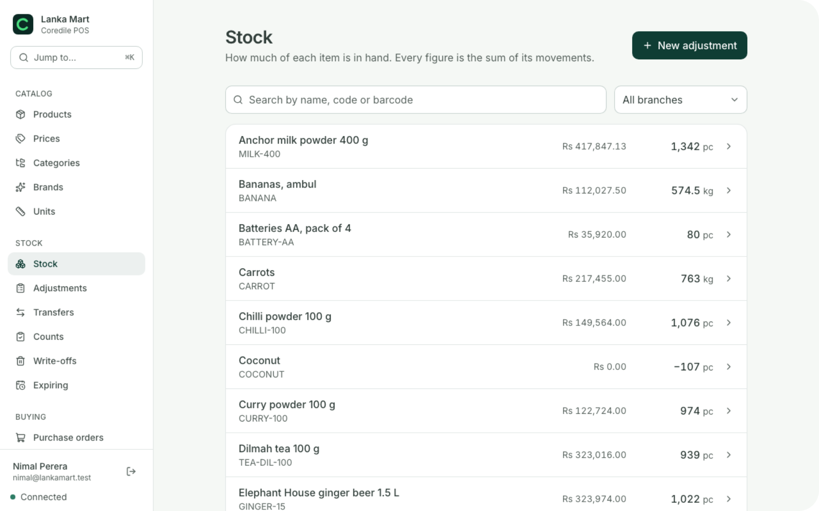

STOCK AND SUPPLIERS
Always know what’s on the shelf.
Every sale takes items off the stock by itself
See what’s running low before it runs out
Order from suppliers, and check what arrives
Move stock from one branch to another
Count the shelves and see what went missing
Notes:
No more counting everything by hand on a Sunday. Every sale takes the items off the stock by itself. You can see what is running low before it runs out, send orders to your suppliers, and check what actually arrives. If you have more than one branch, you can move stock between them. And when you do count the shelves, Coredile shows you what went missing, so you can stop the losses.

Slide 9


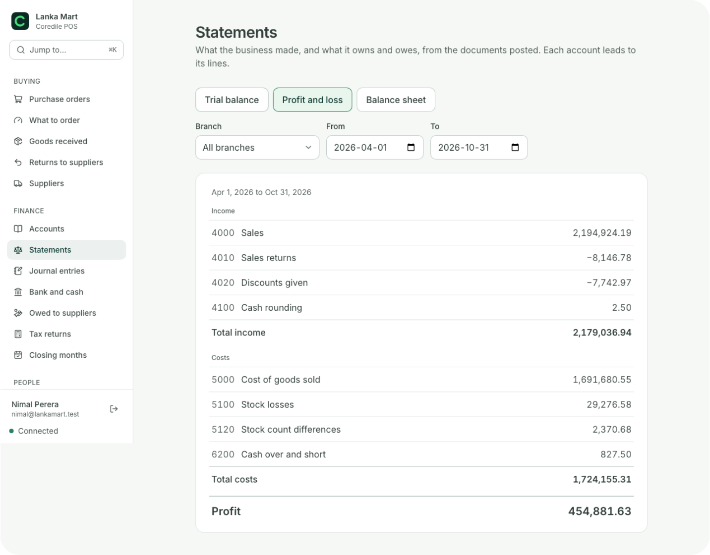


ACCOUNTS
Clean books for your accountant.
Profit and loss, for any
month
What you owe each
supplier
What your customers
owe you
A VAT and SSCL
summary each month
Every bill, delivery and refund writes itself into the books. Download any
report for Excel.
Notes:
No more bag of papers for the accountant at the end of the month. Every bill, every delivery from a supplier and every refund writes itself into the accounts as it happens. So at any time you can see your profit and loss, what you owe your suppliers, and what your customers owe you. Every month you also get a VAT and SSCL summary to give to your accountant. Any report can be downloaded for Excel.

Slide 10




FOR THE OWNER
See every branch from your phone.
Coredile POS
7:00 a.m.
Yesterday at Spice Garden
Big refunds need a manager’s PIN
Good morning, Nimal. Here’s how yesterday went.
Every refund, price change and drawer opening is
saved, with who did it and when
Rs 486,250
+12% on last Friday
Each person sees only what their job needs
Colombo 7
Rs 301,400
Nugegoda
Rs 184,850
Compare your branches side by side, for any day or
month
2 refunds are waiting for you to approve
Notes:
The owner does not need to be in the shop to know what is happening. Every morning at 7, an email arrives with yesterday’s sales, branch by branch, next to the same day last week. Any time, the owner can open the back office on their phone. Big refunds need a manager’s PIN. Every refund, price change and drawer opening is saved with who did it and when. And each staff member only sees the screens their job needs. This gives the owner peace of mind.

Slide 11




WHO IT’S FOR
Made for the way you already work.
Restaurants
Cafés
Bakeries
Shops
Tables, kitchen tickets,
waiters on their phones,
split bills and the service
charge.
Quick counter billing,
and a recipe behind
every drink, so you know
what it costs.
Plan the morning bake,
know what each loaf and
cake costs, and see
what’s left.
Barcodes, stock in every
branch, buying from
suppliers, and customers
on credit.
Notes:
Coredile is made for four kinds of business. Restaurants get tables, kitchen tickets, waiters ordering on their phones, split bills and the service charge. Cafés get quick billing at the counter and know what every drink costs. Bakeries can plan the morning bake and know what each loaf and cake costs to make. Shops get barcodes, stock in every branch, buying from suppliers, and customers who pay at the end of the month. Ask them: which one is you?

Slide 12
WHAT CHANGES
Your day, before and after.
Without Coredile
With Coredile
Stock
Counted by hand on Sundays
Goes down with every bill
Food cost
A guess
Known for every plate
Accounts
Typed up at the end of the month
Written as you sell
Internet down
Billing stops
Billing carries on
Closing time
A long cash count
The till shows short or over
The owner
Phones each branch
Gets one email at 7 a.m.
Notes:
Here is the simple picture. Without Coredile, stock is counted by hand, food cost is a guess, the accounts are typed up at the end of the month, billing stops when the internet goes down, closing takes a long time, and the owner has to phone each branch. With Coredile, all of that happens by itself while you sell. You save hours every week, and you stop losing money you can’t see.

Slide 13
PRICES
One price per branch.
No charge per user, per product or per bill. Two tills in every branch.
Shop
Bakery
Restaurant
Rs 4,500
Rs 6,500
Rs 8,500
a month per branch
a month per branch
a month per branch
Billing, stock, suppliers, customer
credit, accounts and every report.
Everything in Shop, plus recipes, the
morning bake and what each item costs
to make.
Everything in Shop, plus tables, kitchen
tickets, waiters’ phones and food cost.
Extra till: Rs 1,500 a month
Offers and Loyalty: Rs 2,000 a month per branch
Pay yearly: 2 months free
Setup and training are agreed with you, in writing, before we start.
Notes:
Our prices are simple. You pay one price per branch, per month. There is no extra charge for more staff, more products or more bills. Every branch gets two tills in the price. Shop is Rs 4,500 a month. Bakery is Rs 6,500. Restaurant is Rs 8,500. If you need a third till, it is Rs 1,500 a month. Offers and Loyalty, for deals, points and gift cards, is Rs 2,000 a month per branch. If you pay for a year, you get 2 months free. Setup and training depend on your business, and we agree that price with you in writing before anything starts. Prices are in Sri Lankan rupees; VAT is added if it applies.

Slide 14
WHAT YOU NEED
Simple to start.
You bring
We do
A Windows PC or laptop for each till
Load your products and recipes, from Excel or
even a printed menu
A receipt printer
Set up your tills and branches
A cash drawer and barcode scanner, if you want
them
Train your staff
Waiters use their own phones
Answer when you call us for help
No hardware yet? We’ll give you a price for all of it.
You check everything before you start selling.
Notes:
Getting started is easy. You need a Windows PC or laptop for each till, and a receipt printer. A cash drawer and a barcode scanner are up to you. Waiters use their own phones, so there is nothing extra to buy for them. If you don’t have the hardware yet, we can give you a price for all of it. We do the hard part: we load your products and recipes, even from an Excel sheet or a printed menu, set up your tills, and train your staff. And when you need help, you call us.

Slide 15

GETTING STARTED
Four simple steps.
1
2
3
4
Free demo
Agree the price
We set it up
Start selling
We show you Coredile working
with products like yours.
You get the setup and training
price in writing.
We load your products, set up
your tills and train your staff.
Pay by the month or by the
year.
No long contract. You pay month by month, or pay for 10 months and use it for 12.
Notes:
Here is how we start. First, a free demo, like today, with products like yours. Second, we agree the setup and training price, and you get it in writing. Third, we come and set everything up: we load your products, set up your tills and train your staff. Fourth, you start selling. There is no long contract. You pay month by month, or pay for a year and get 2 months free. The tills start billing once the first invoice is paid, and each invoice is emailed to you 10 days before it’s due.

Slide 16



WHO MAKES IT
Built in Sri Lanka,
by people you can call.
Your data is backed up every day
8
80+
No other business can ever see your data
Updates come to you, at no extra cost
years building software for
businesses
projects delivered
Help from the people who built it
Notes:
Coredile POS is made by Coredile, a Sri Lankan software company. We have spent 8 years building software for businesses, and delivered more than 80 projects. Your data is backed up every day, and no other business can ever see it. Updates come to you at no extra cost. And when you need help, you talk to the people who actually built the system, not a call centre.

Slide 17

NEXT STEP
Book your free demo.
We’ll show you Coredile with products like yours. Bring all your questions.
EMAIL
WEBSITE
WHATSAPP
hello@coredile.com
coredilepos.cloud
+94 72 282 2060
Notes:
Thank you. The best way to see if Coredile is right for you is a free demo with your own kind of products. We can do it at your shop, or here. Ask: when is a good day for you this week? Leave the contact details with them, and write down their business type and number of branches so the demo is ready for them.

